Slide 1
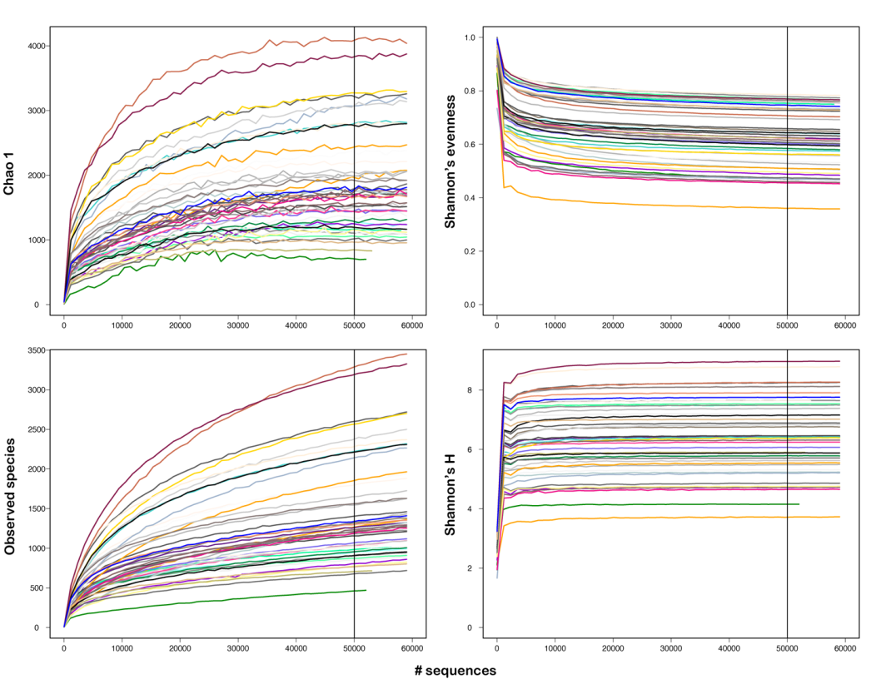
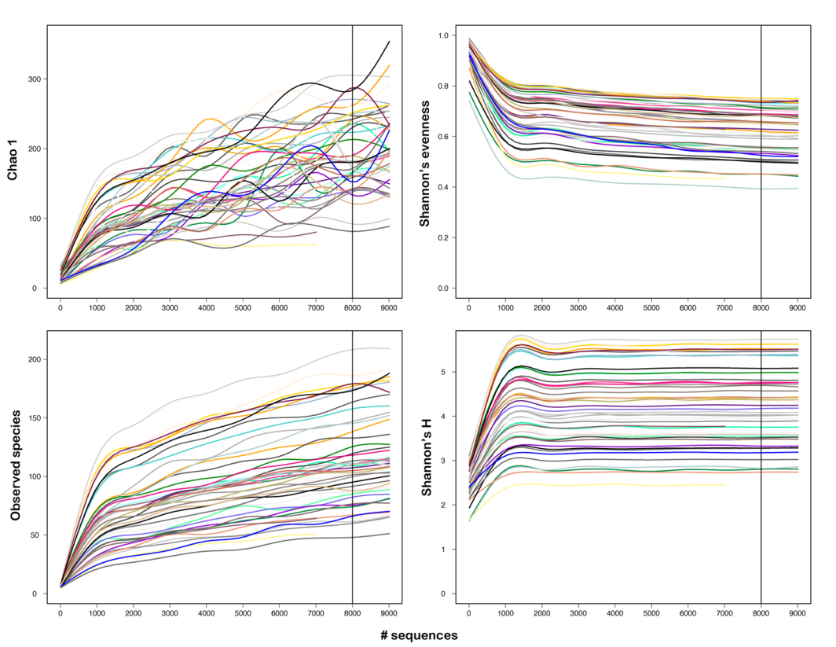
a
b
Figure S1: Sample rarefaction curves of alpha diversity indices for bacterial (a) and protists (b) datasets.

